Slide 1


WE ARE TRAFFIC
HEROES
SAVING YOU
FROM
TRAFFIC JAMS

Slide 2
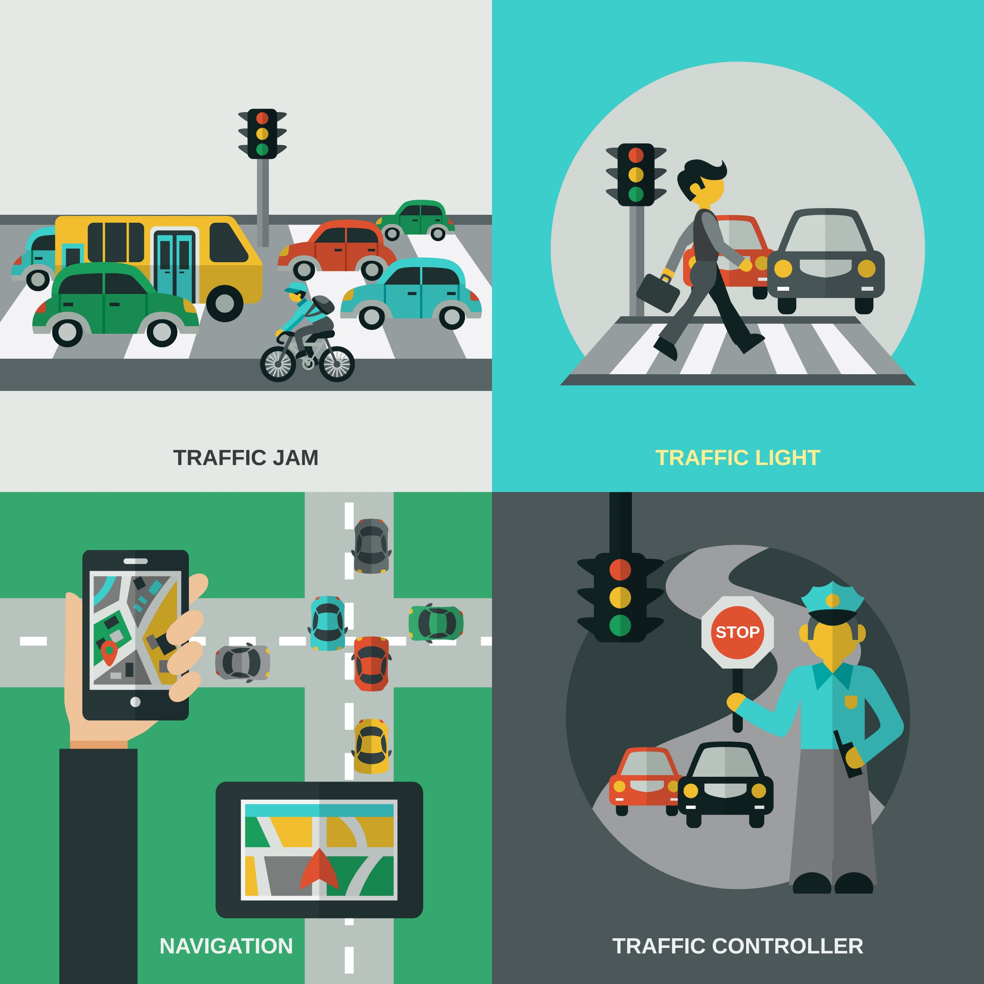




The Problem
In Germany are 456.657 hours trafficjams every year
• Production of a large volume of
harmful CO2
• Higher fuel consumption
• Frustrated drivers engaging in
road rage
• Loss in productivity and in the
drivers' personal lives
Traffic lights are not connected and smart
Every year there are ca. 1.000.000 additional cars
Construction sites are not always visibile on maps
Notes:
Problem:
Too much traffic in big citys
More and more cars on the road
Traffic lights are not smart
456657 h of traffic only in Germany

Slide 3
Prototype
Edge Device
Traffic signals
container
Camera
Video signal
Traffic analyses
secure algorithm
Construction site
information
Notes:
PROBLEM STATEMENT
None of big ideas to resolve the traffic congestion can deliver a complete solution and most of them only temporary solve congestion problems. Widening roads leads to an improved state until a certain limit when demand increase. Sophisticated solutions, such as the traffic light optimization systems or construction site visibility are still underdeveloped despite it has been proved that these solutions yield improvements in traffic performance 15% more compared to fixed timing systems ("Urban traffic control systems: Evidence on performance". Institute for Transport Studies, University of Leeds. Retrieved 4 September 2013). There are some projects going on such as SCOOT in UK but still, in Germany we see no such
Edge computing - lot of the processing is happening on cloud and we want to avoid because a lot of data is not needed. we analyse data on edge device and transfer only meaningful data onto the could - decision making based on edge computing
WHAT OUR SOLUTION BRINGS IN
save on energy compustion, storage space, computing power, increase the visibility of data wich can be further used

Slide 4
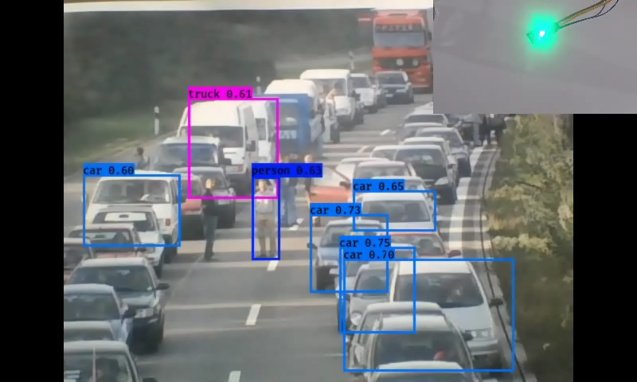

Slide 5








The Smart Roads ecosystem
economic damage 5.1 bil
traffic optimization 15 %
SAVINGS 765 mil
Im so happy!
Driver
Map provider
Government
Map information
Traffic light
companys
Savings
€
€
Cloud analytic
service
Construction site info
Potential Businesspartners
Senisng device
Business Owner
€
Leads to
€
Clear roads
Data information
Devices
€
Dig. service
Data
Ads
Digital service
Provider (tech)
Road construction companys
Notes:
PROBLEM STATEMENT
None of big ideas to resolve the traffic congestion can deliver a complete solution and most of them only temporary solve congestion problems. Widening roads leads to an improved state until a certain limit when demand increase. Sophisticated solutions, such as the traffic light optimization systems or construction site visibility are still underdeveloped despite it has been proved that these solutions yield improvements in traffic performance 15% more compared to fixed timing systems ("Urban traffic control systems: Evidence on performance". Institute for Transport Studies, University of Leeds. Retrieved 4 September 2013). There are some projects going on such as SCOOT in UK but still, in Germany we see no such
Edge computing - lot of the processing is happening on cloud and we want to avoid because a lot of data is not needed. we analyse data on edge device and transfer only meaningful data onto the could - decision making based on edge computing
WHAT OUR SOLUTION BRINGS IN
save on energy compustion, storage space, computing power, increase the visibility of data wich can be further used

Slide 6
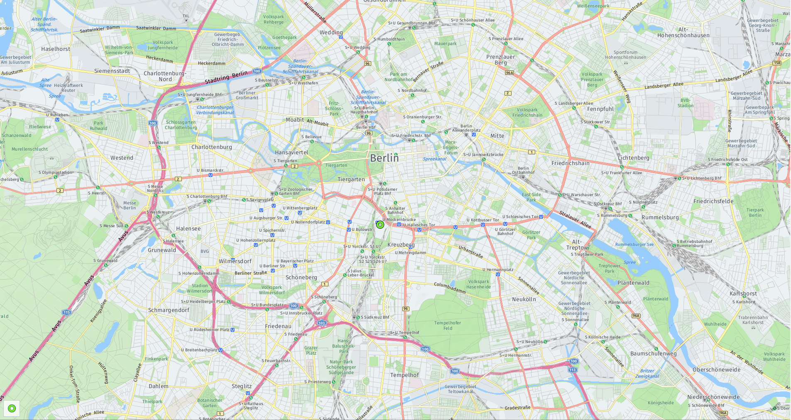





Slide 7

Partners:
Bosch IoT Suite
here maps
Streamr
Raspberry foundation
Open cv

Slide 8

SCAN THE CODE FOR MORE INFO!

